Slide 1

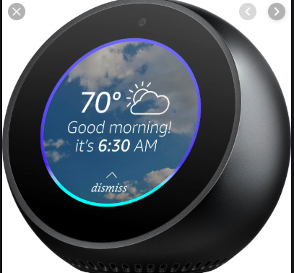

3253 Machine Learning Term Project
Addie Blohm

Slide 2
Objective
Provide insights on Amazon Echo product using sentimental and text analysis
Use Machine Learning (Naïve Bayes, Support Vector Machine, and Deep Learning) to predict rating based on reviews 1-5
Multi Classification Problem

Slide 3
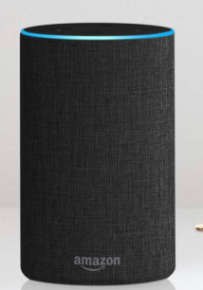
Data Preparation
Over 3,000 data points Collected in one Month in Summer 2018
Rating, Date, Variation, Verified Reviews and Feedback
Removed data points with no reviews
Cleaned text by removing special characters and stop words
Vectored Data Set

Slide 4
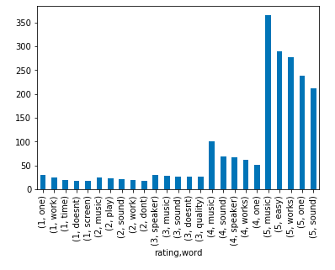
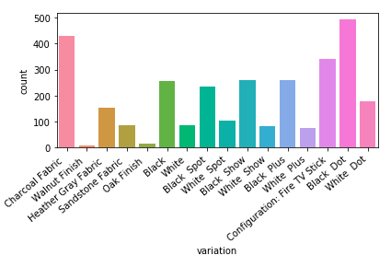
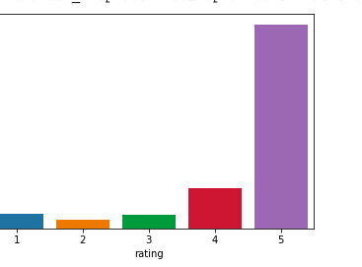
Data Insights
Average 4.46 Rating
Median 5 Rating

Slide 5
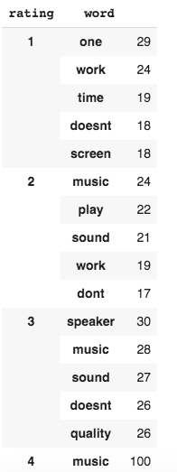
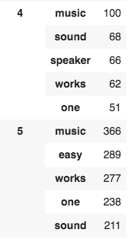
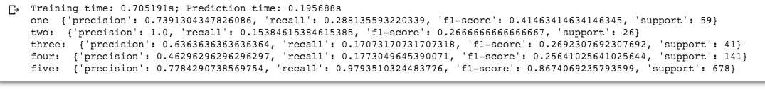
Models
Naïve Bayes
Simple algorithm for average or above results
77% Accuracy
Support Vector Machines
Great Machine Learning Algorithm to use for text analysis for classification
Average Accuracy 58%

Slide 6
Conclusion
Naive Bayes
Support Vector Machines
%77
% 79
Model Summary
Overall a very solid product based on reviews
Next steps would be evaluating the product by the type of versions of the product
Fine tuning model
Learning Outcomes
Text Analysis
Sentimental Analysis

